Slide 1


Slide 2

Splash Screen
This is just temporary, I’ll make a better splash screen later ☺

Slide 3
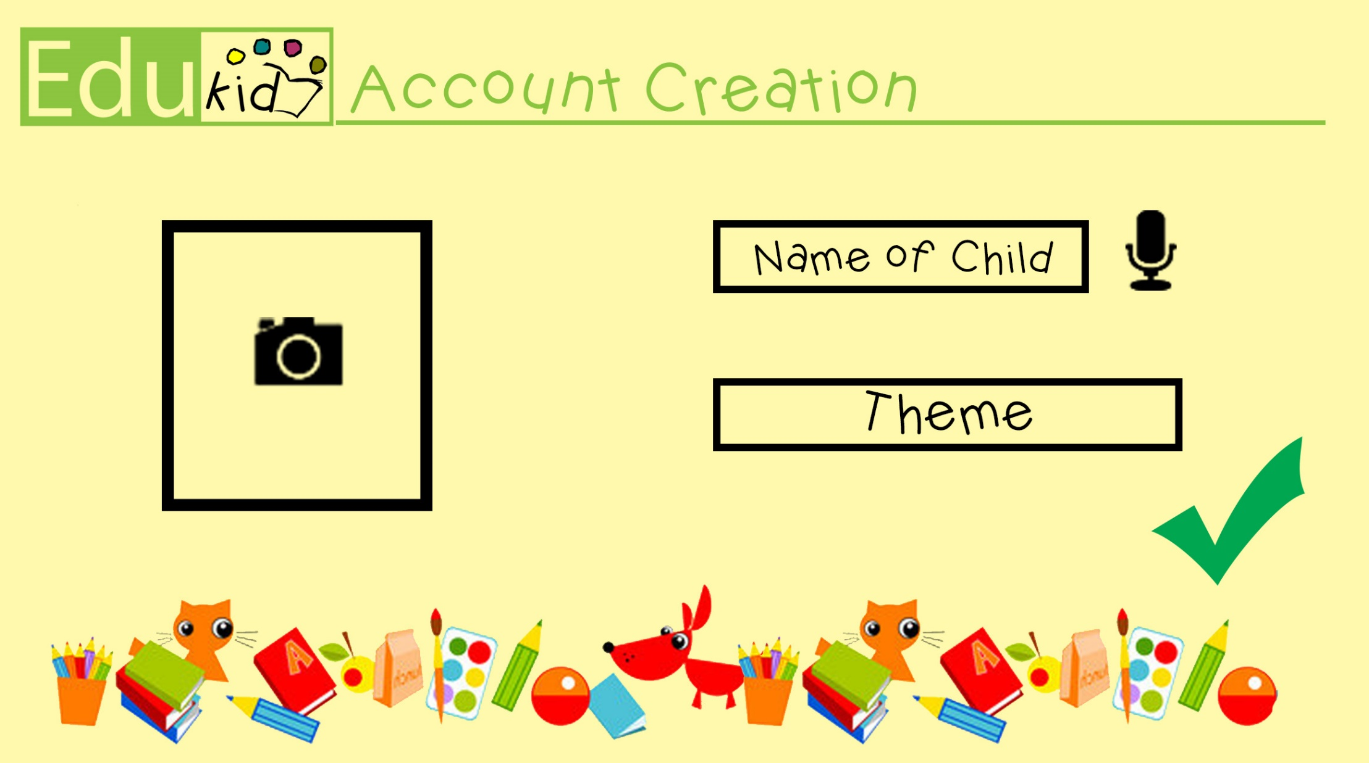
Account Creation Page

Slide 4

Main Menu

Slide 5

Alphabet Game Page

Slide 6
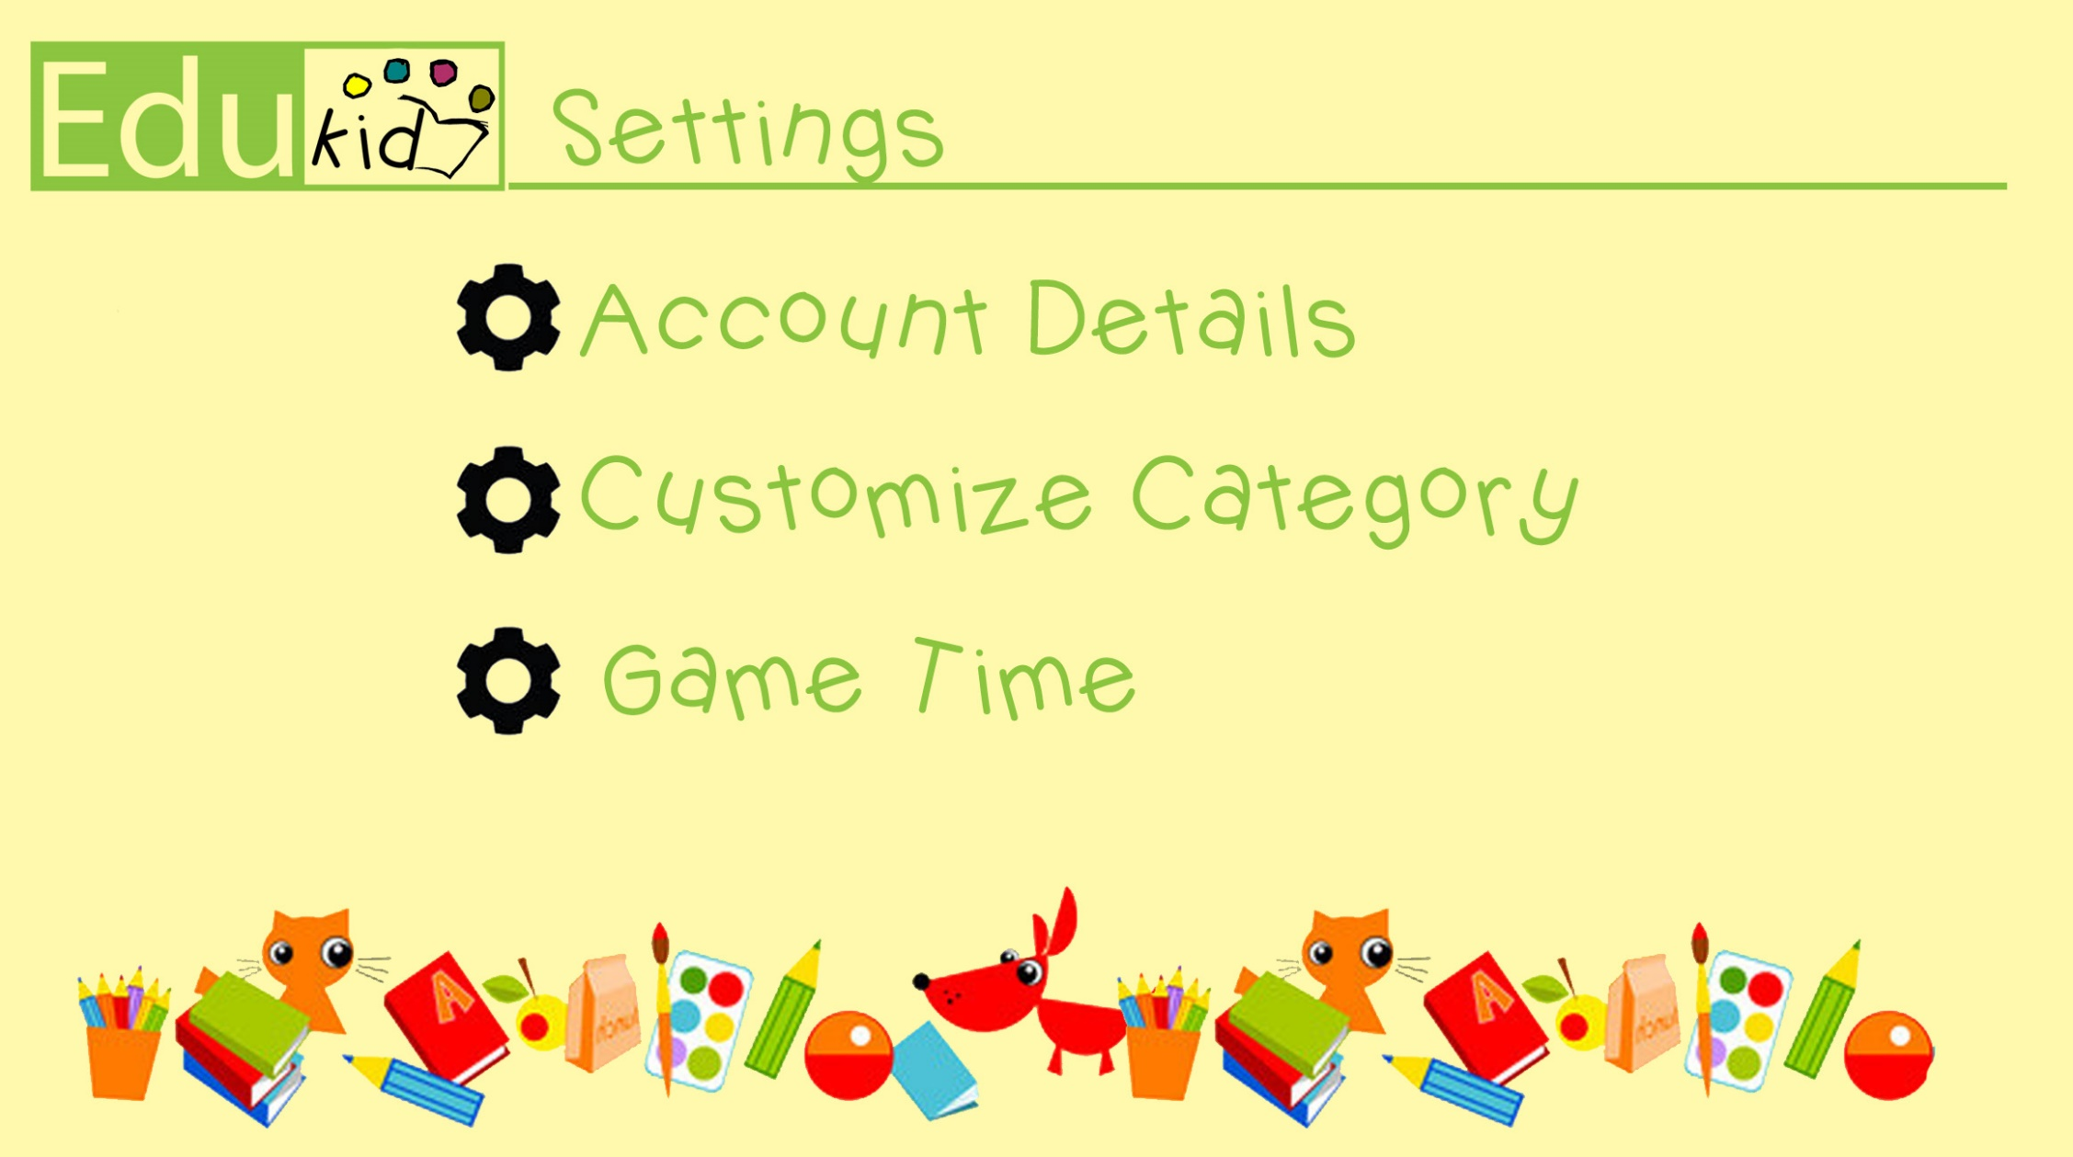
Settings Page

